Slide 1
Performance of previous methods on AVNRT data
August 2024
Andrea Corrado

Slide 2
Outline
Recap of problems found so far
Filtering strategy
Spectrum estimation
Alignment strategy
Final questions and conclusion

Slide 3
Recap of problems found
So far, data has been explored to find out their inner characteristics.
Proprieties in time domain
Proprieties in frequency domain
But at least three problems were encountered:
Data require preprocessing
Spectral analysis is hard due to inner limits of methods
Data require alignment
Target 1 : building a population dataset
Target 0: Answer to:
How preprocess data?
How frequency characterise these signals?
How align data?

Slide 4
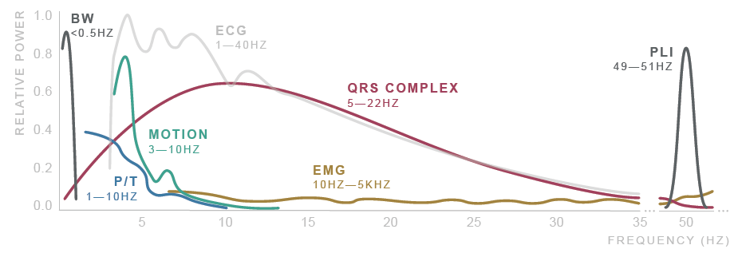
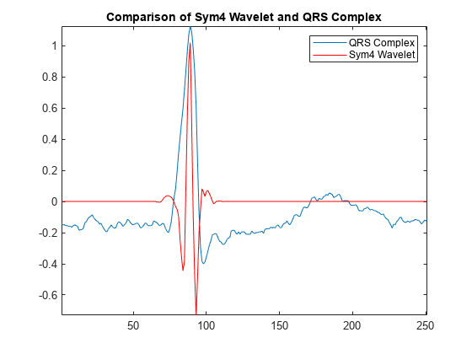
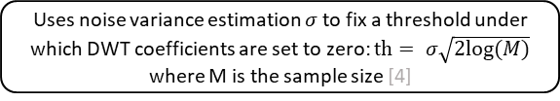
Signal preprocessing
ECG signals noisy and require to be preprocessed and filtered [1]
Noise sources: Physiological, Environmental, Artifacts, Electronic…
After literature research, the proposed filtering method [1,2] consists of:
Donoho thresholding [3] on discrete wavelet transform coefficients (DWT)
Shrink the coefficients related to, presumably, high frequency noise and low frequency noise
Followed by zero-phase band pass filtering
Improves the result eliminating residual noise
Original signal
DWT decomposition
Symlets 4 wavelet is used due to its good performances on ECG signals [2, 3]
Donoho soft thresholding
Uses noise variance estimation $σ$ to fix a threshold under which DWT coefficients are set to zero: $th= σ\sqrt{2log⁡(M)}$ where M is the sample size [4]
DWT reconstruction
Butterworth HP filter (order 6, cutoff at 0.5 Hz)
Butterworth LP filter (order 6, cutoff at 70 Hz)
1. Saraiva, João & Plácido da Silva, Hugo & Fred, Ana. (2022). Denoising and Artifact Removal of the Electrocardiogram, Electrodermal Activity and Accelerometery for Continuous Ambulatory Monitoring of Epileptic Seizures with Wearable Devices.
2. Singh, Brij N., and Arvind K. Tiwari. "Optimal selection of wavelet basis function applied to ECG signal denoising." Digital signal processing 16.3 (2006): 275-287.
3. Donoho, David L. "De-noising by soft-thresholding." IEEE transactions on information theory 41.3 (1995): 613-627.

Slide 5
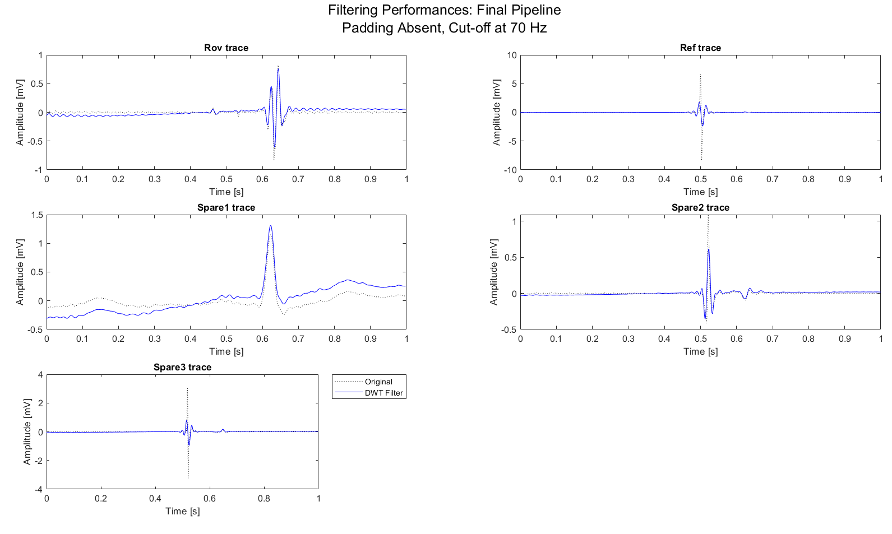
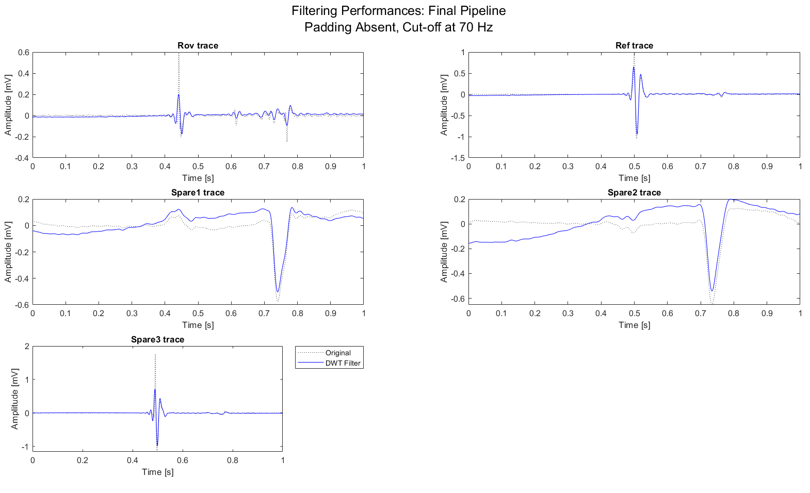

Preprocessing results
Proposed method ensures the best compromise between noise removal and signal conservation.
MAP C, sub-1, record example
MAP C, sub-7, record example
MAP C, sub-8, record example
Moreover:
Zero-phase ensures the preservation of peaks location
Tail effects mitigation
Important peaks (A-H-V) preserved

Slide 6
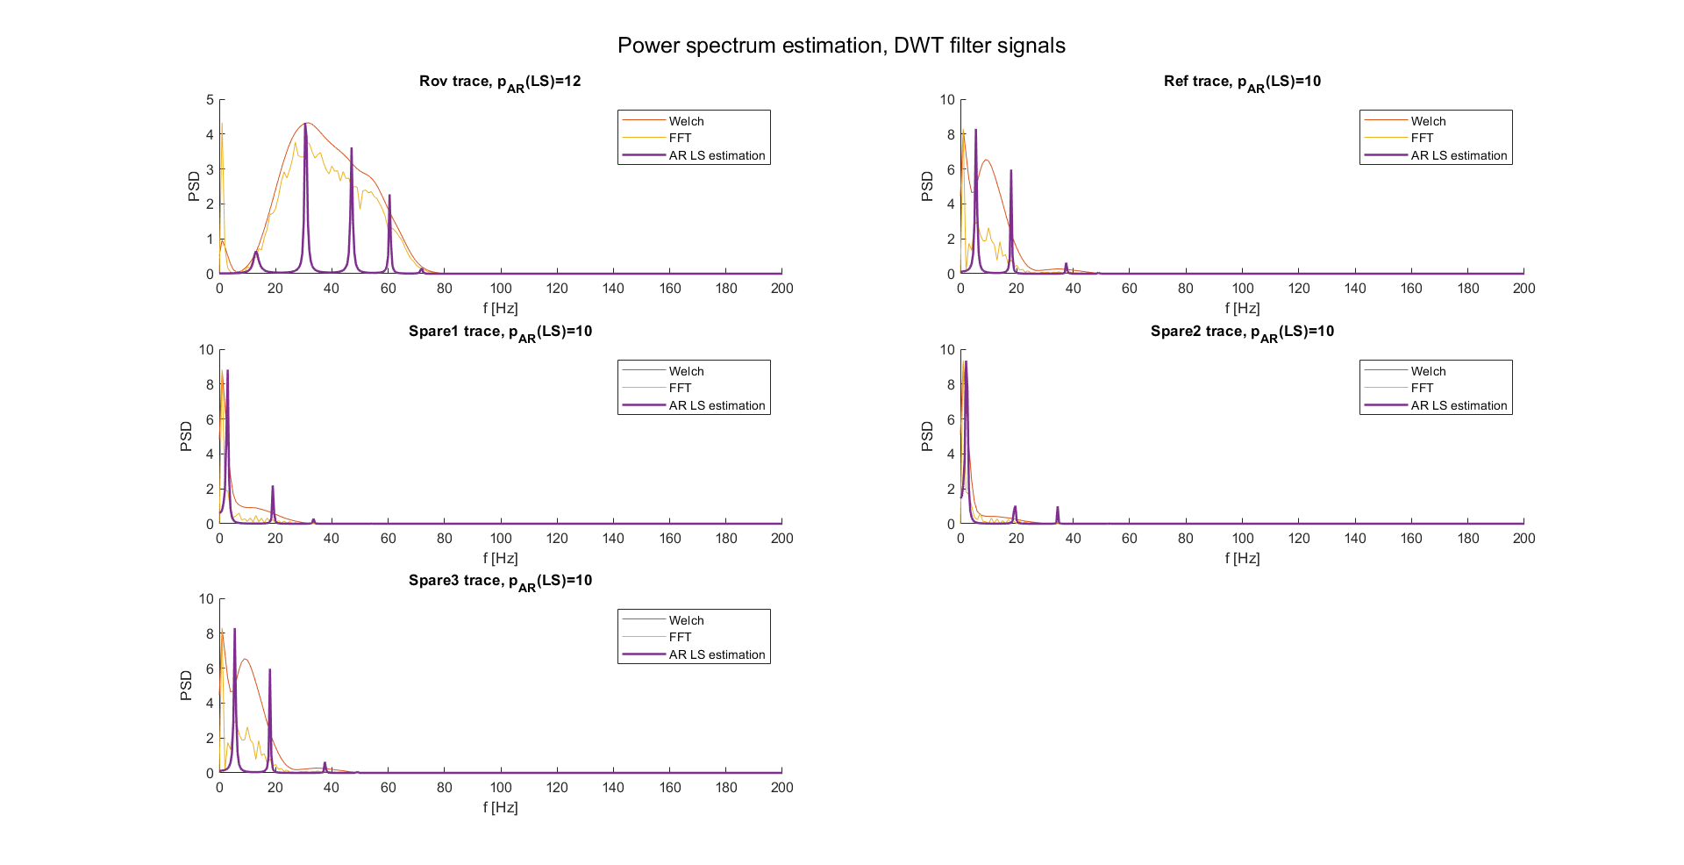
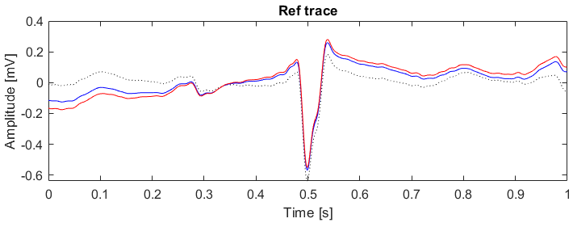
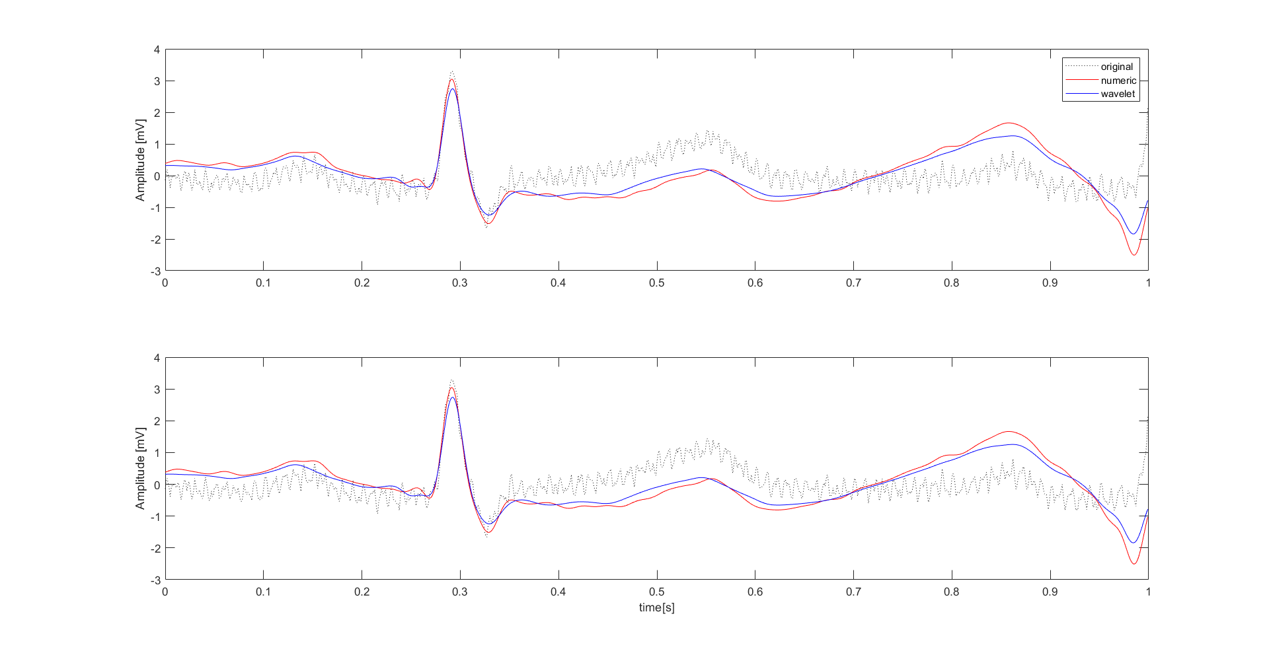
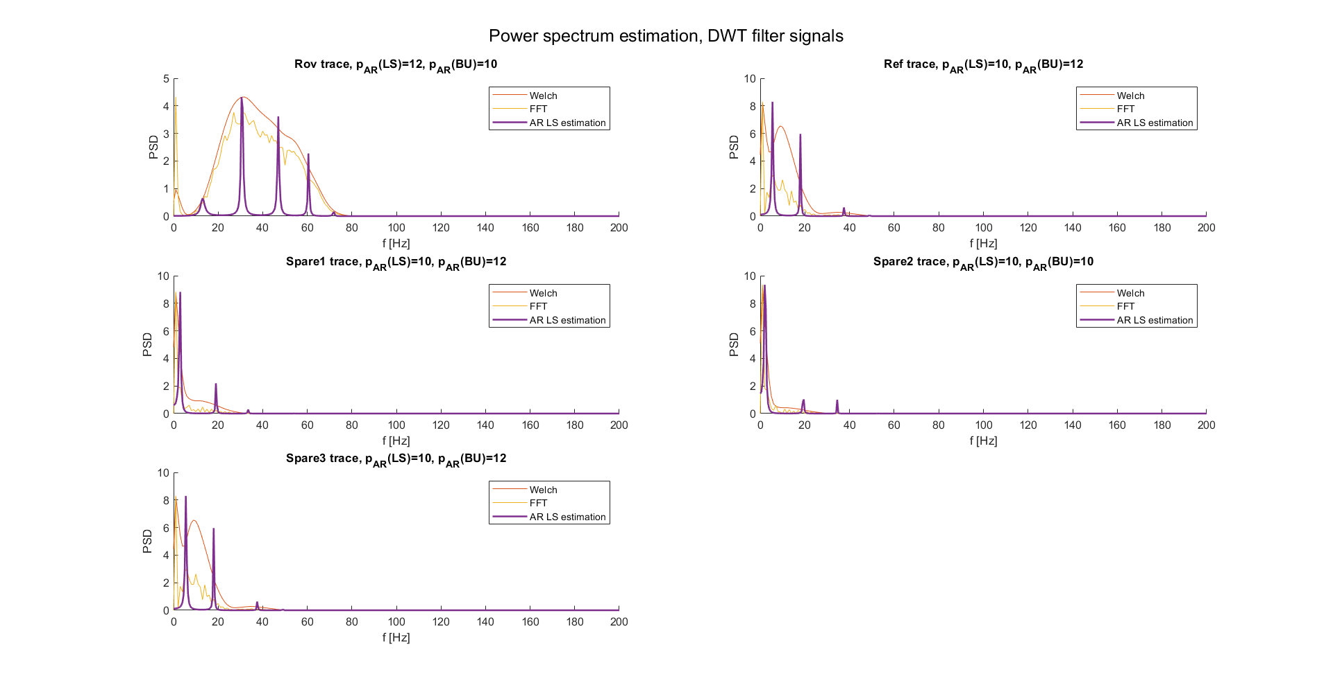
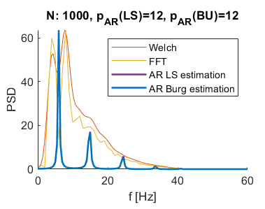
Spectrum estimation
Spectrum estimation is affected by filtering performances and estimation method. As know from previous steps:
LS estimation provides spectrums with high frequency resolution
Filters can be optimized (as done)
So, spectrum estimation pipeline was applied on filtered signals.
First on a single beat ECG (compared with the previous obtained results)
Then on records examples (Rov, Ref…)
Performance are satisfying, but this is just one example. It’s possible that in the next steps data will require scaling (i.e., min-max scaling) to ensure comparable spectrums.
Should be noted that these results allow to clearly distinguish signals (not only between Rov traces and others, but even between possibly different References).
DWT thresholding and BP filter
AR order estimation using nAIC criterion
AR spectrum estimation using LS estimator
Signal
AVNRT record
Didactical HF example

Slide 7
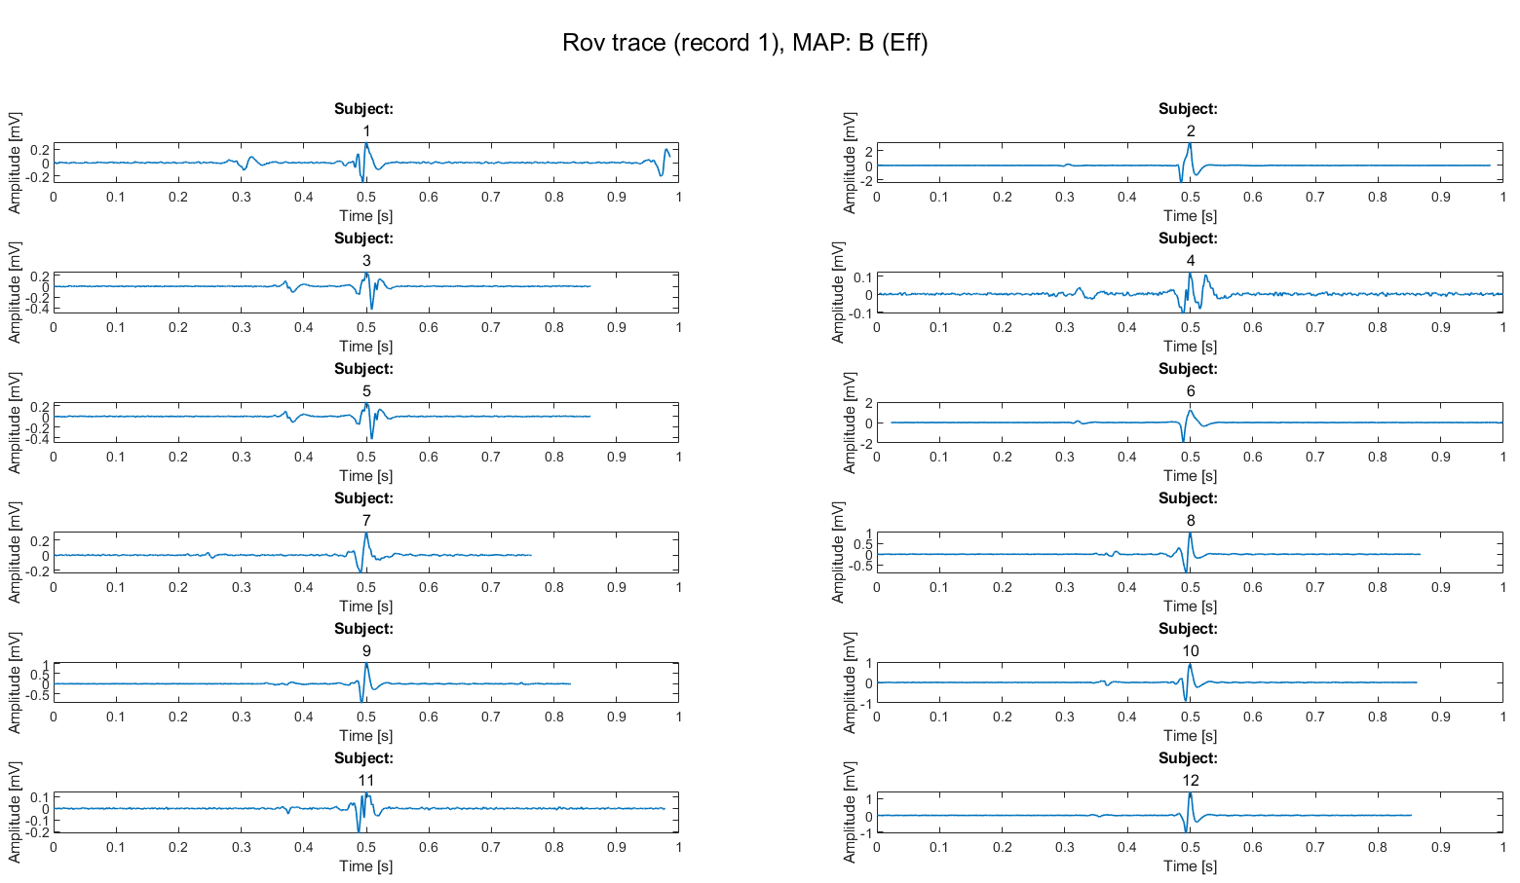
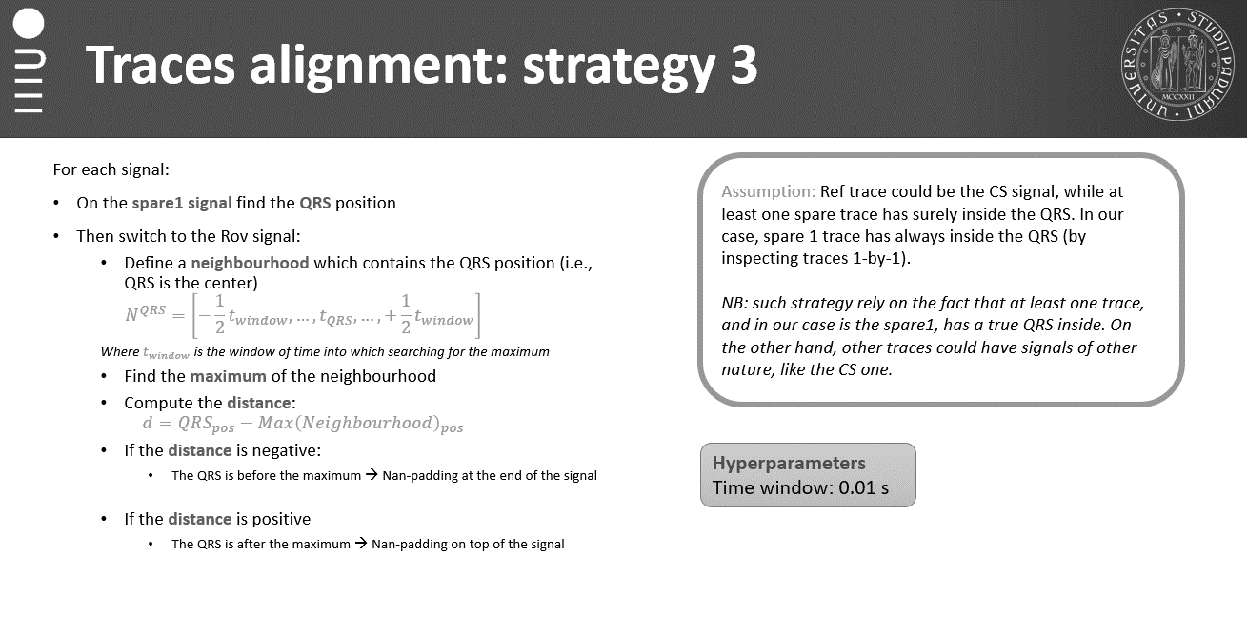
Alignment results
As observed previously, the best alignment strategy (under strong assumptions) was:
Find QRS into spare 1
Define the neighborhood into Rov trace around QRS point
Find the maximum into Ref neighborhood: Fiducial Point.
Aling the FC respect to the QRS.
Such strategy performs well on single subjects, but what if all Fiducial points found would be aligned respect to a common point? (i.e., half trace, 0.5 seconds).
The implemented strategy allow not only to align traces, but even with clear interpretability of traces peaks, leading to the possibility of repeating population analysis.

Slide 8
Further steps
Further steps from now on could be:
Remaking population analysis
Is it necessary to scale data?
Which are the common patterns?
Which are the differences, if observable, between maps?
Building a robust feature extraction pipeline
Which features are used in ECG single beat classification tasks?
Which of them could be used in our case?
Then proceeding with a supervised model evaluation
Which are the most common strategies used in similar tasks?
Supervised or unsupervised models? Other?

Slide 9
Outline
Recap of methods studied so far
Application on AVNRT data
ECG filtering
Spectrogram estimation
Alignment results
Further steps
Other possible routes: Scalogram
Theory
Application on didactical examples
Application on AVNRT data
Conclusions

Slide 10
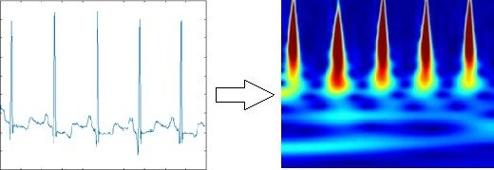
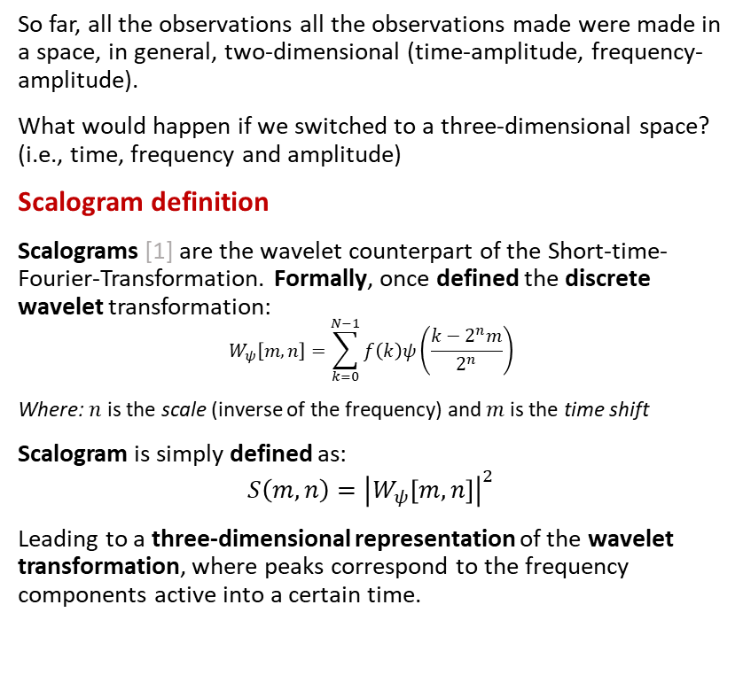
Scalogram: theory
So far, all the observations all the observations made were made in a space, in general, two-dimensional (time-amplitude, frequency-amplitude).
What would happen if we switched to a three-dimensional space? (i.e., time, frequency and amplitude)
Scalogram definition
Scalograms [1] are the wavelet counterpart of the Short-time-Fourier-Transformation. Formally, once defined the discrete wavelet transformation:
$$W_{ψ}\left[m,n\right]=\sum_{k=0}^{N−1}{f\left(k\right)ψ\left(\frac{k−2^{n}m}{2^{n}}\right)}$$
Where: $n$ is the scale (inverse of the frequency) and $m$ is the time shift
Scalogram is simply defined as:
$$S\left(m,n\right)={\left|W_{ψ}\left[m,n\right]\right|}^{2}$$
Leading to a three-dimensional representation of the wavelet transformation, where peaks correspond to the frequency components active into a certain time.
1. J. Bialasiewicz, "Application of Wavelet Scalogram and Coscalogram for Analysis of Biomedical Signals," Proceedings of the Conference, July 2015.

Slide 11
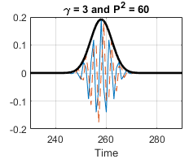
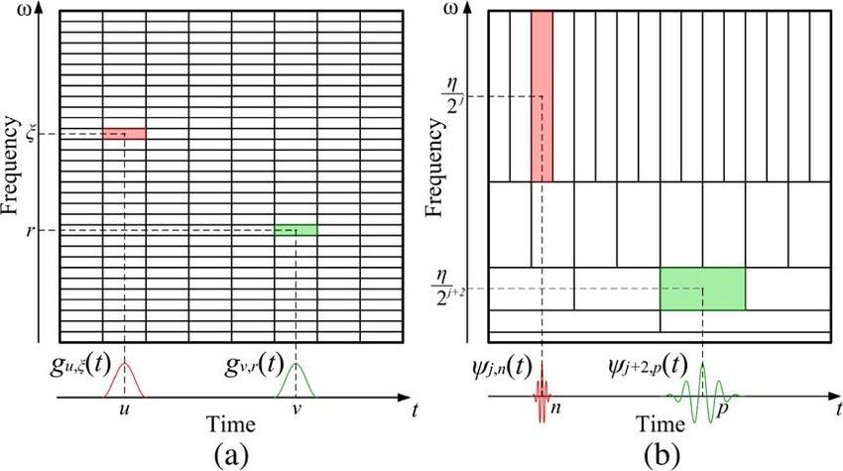
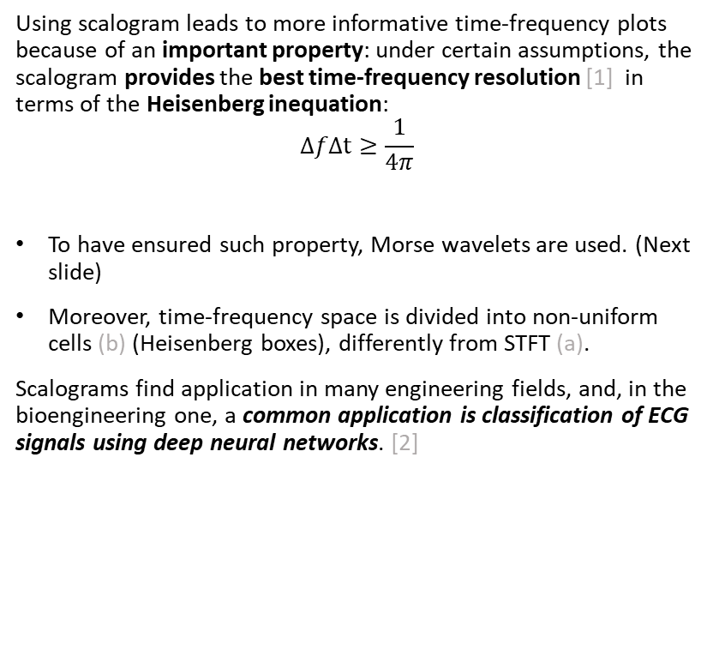
Scalogram: theory
Using scalogram leads to more informative time-frequency plots because of an important property: under certain assumptions, the scalogram provides the best time-frequency resolution [1] in terms of the Heisenberg inequation:
$$ΔfΔt≥\frac{1}{4π}$$
To have ensured such property, Morse wavelets are used. (Next slide)
Moreover, time-frequency space is divided into non-uniform cells (b) (Heisenberg boxes), differently from STFT (a).
Scalograms find application in many engineering fields, and, in the bioengineering one, a common application is classification of ECG signals using deep neural networks. [2]
2. Daydulo, Y.D., Thamineni, B.L. & Dawud, A.A. Cardiac arrhythmia detection using deep learning approach and time frequency representation of ECG signals. BMC Med Inform Decis Mak 23, 232 (2023).

Slide 12
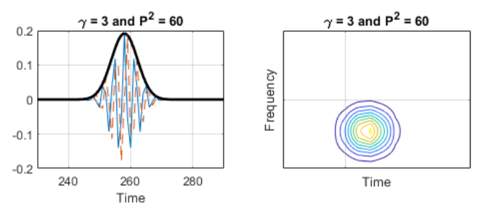
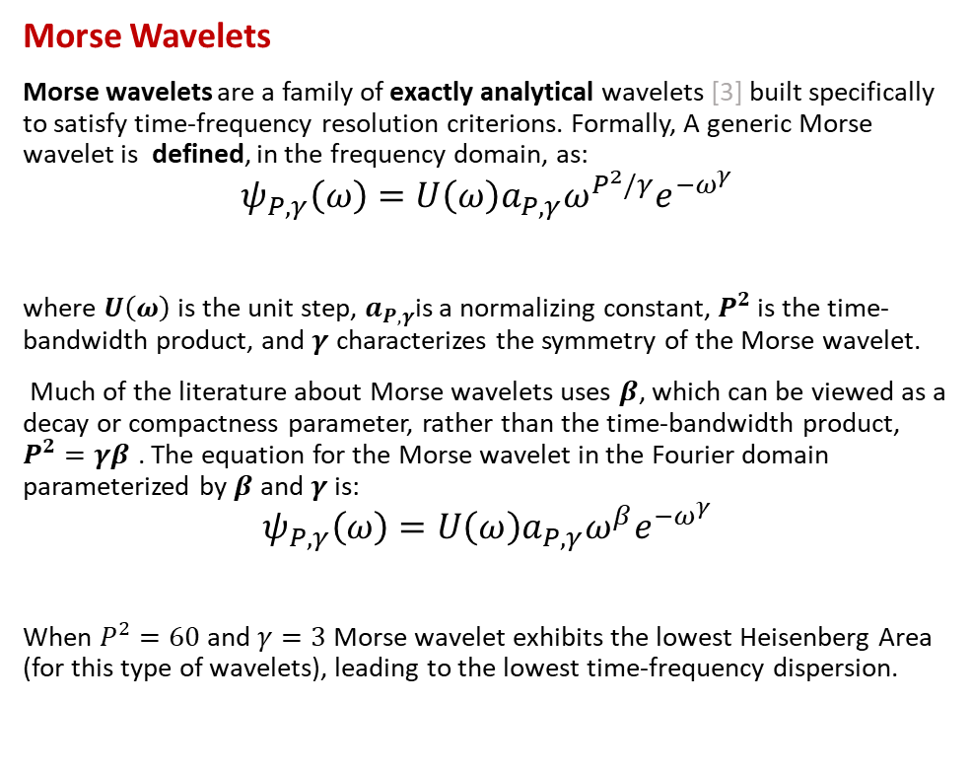
Scalogram: theory
Morse Wavelets
Morse wavelets are a family of exactly analytical wavelets [3] built specifically to satisfy time-frequency resolution criterions. Formally, A generic Morse wavelet is defined, in the frequency domain, as:
$$ψ_{P,γ}\left(ω\right)=U\left(ω\right)a_{P,γ}ω^{P^{2}/γ}e^{−ω^{γ}}$$
where $U\left(ω\right)$ is the unit step, $a_{P,γ}$is a normalizing constant, $P^{2}$ is the time-bandwidth product, and $γ$ characterizes the symmetry of the Morse wavelet.
Much of the literature about Morse wavelets uses $β$, which can be viewed as a decay or compactness parameter, rather than the time-bandwidth product, $P^{2}=γβ$ . The equation for the Morse wavelet in the Fourier domain parameterized by $β$ and $γ$ is:
$$ψ_{P,γ}\left(ω\right)=U\left(ω\right)a_{P,γ}ω^{β}e^{−ω^{γ}}$$
When $P^{2}=60$and $γ=3$ Morse wavelet exhibits the lowest Heisenberg Area (for this type of wavelets), leading to the lowest time-frequency dispersion.
3. S. C. Olhede and A. T. Walden, "Generalized Morse wavelets," in IEEE Transactions on Signal Processing, vol. 50, no. 11, pp. 2661-2670, Nov. 2002, doi: 10.1109/TSP.2002.804066.

Slide 13
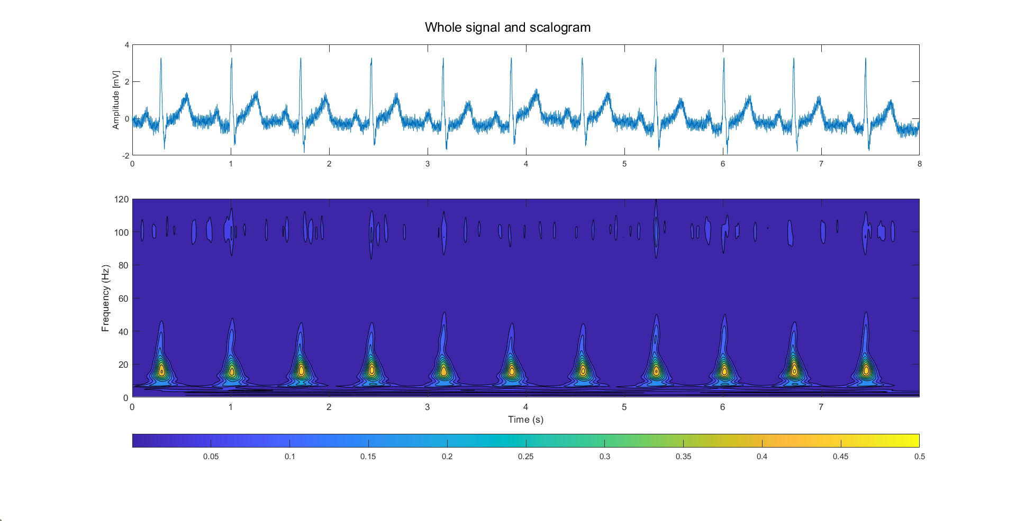
Scalogram: application on external data
Scalogram evaluation can be done directly on ECG signals without filtering, at least to begin.
So, the evaluation pipeline is made of these steps:
Perform DWT on the signal
Transforms coefficients using the scalogram definition
Plot the result
It’s reported an example of scalogram, related to a High frequency noise ECG signal (the well-known didactical one), It’s possible to recognize:
Single beats
Noise presence
Obviously, the scalogram of a signal could be computed after filtering to put in evidence the energy peaks really related to the signal itself.

Slide 14
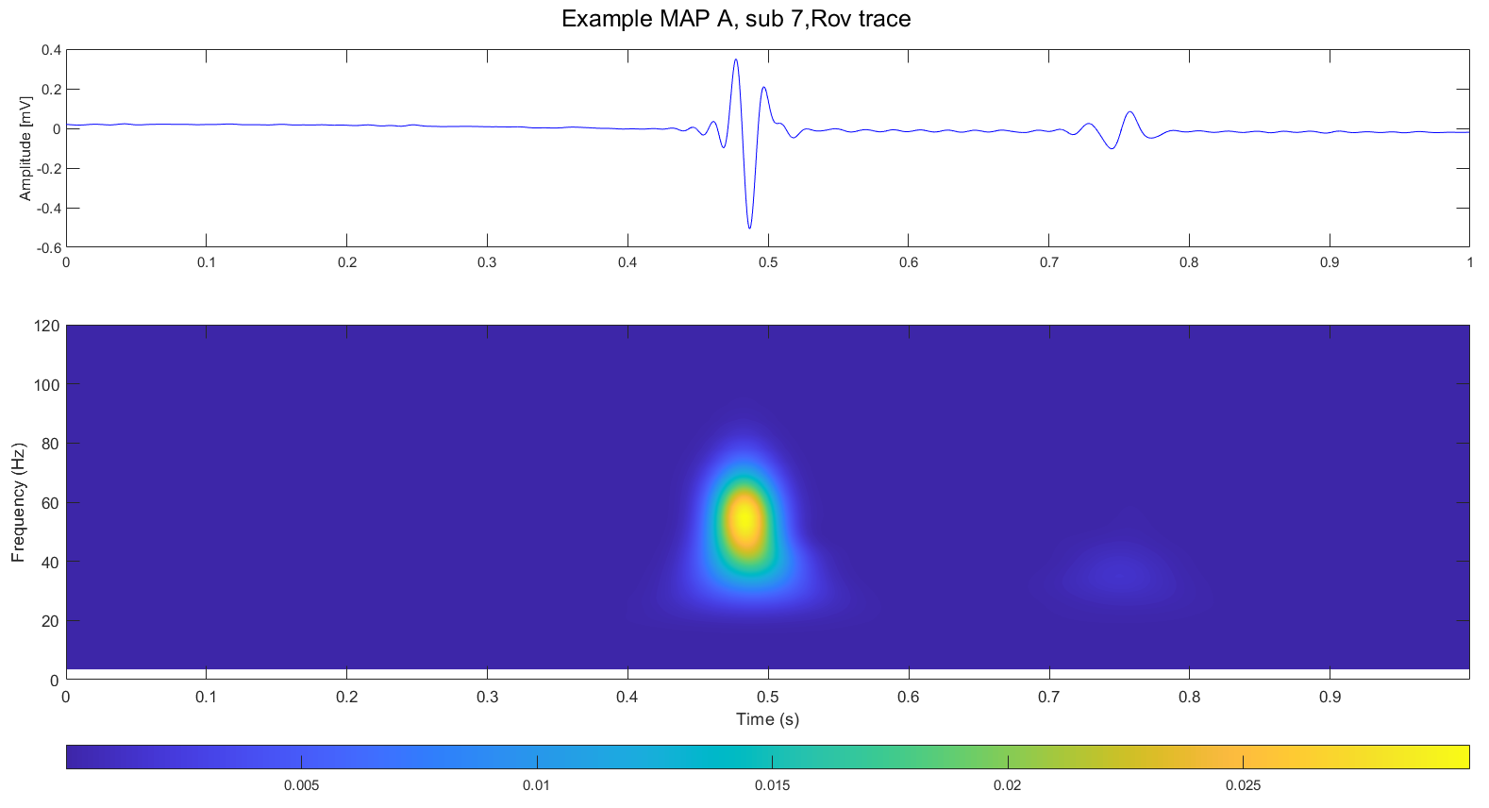
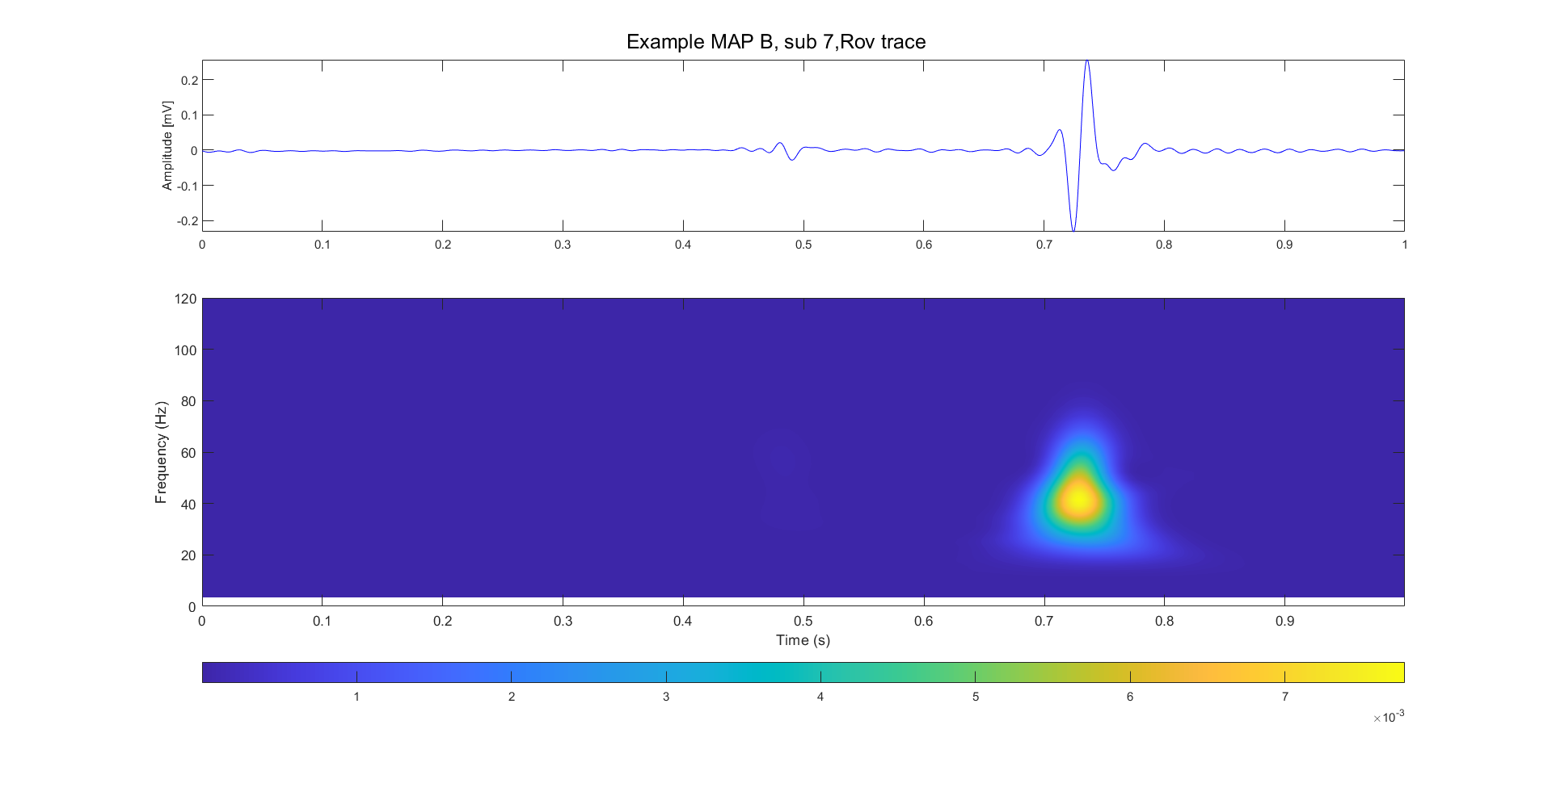
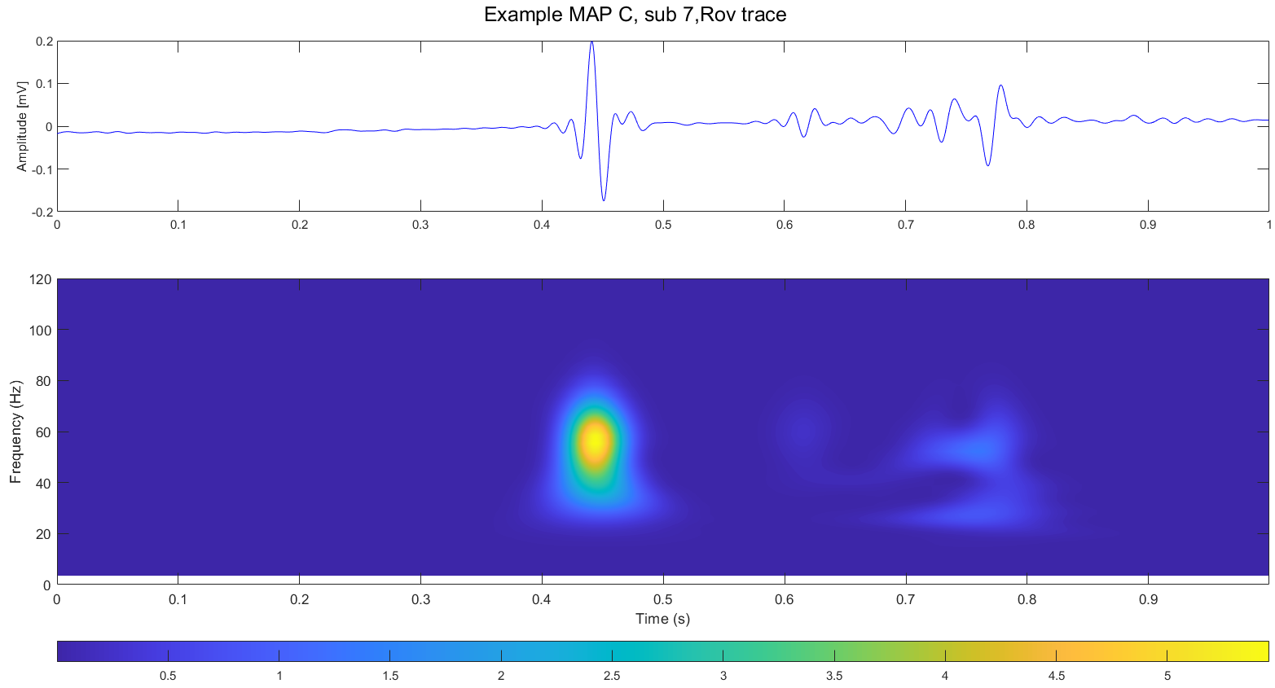
Scalogram: application AVNRT data
Finally, scalogram evaluation pipeline could be applied on AVNRT data to find out if there are observable differences between maps into time-frequency plane.
Here are reported, for the same subject (7), three scalogram:
Rov trace, record 1, MAP A (indifferent)
Rov trace, record 1, MAP B (effective)
Rov trace, record 1, MAP C (dangerous)
All these traces have been filtered and have zero mean.
As can be seen, there are some differences into these scalograms, possibly related to the map.
Again, this is just a single example, probably data require to be scaled to be comparable.
Atrial
Ventricular
His’ bundle

Slide 15
Conclusions
Previously studied methods leads to encouraging results:
Mixed strategy of filtering: with minor differences respect to the original pipeline, the performance are satisfactory.
Spectrum evaluation pipeline: results on single beat comparable with didactical examples and good frequency resolution overall. It’s possible that further steps will require data rescaling.
Moreover, the possibility of using scalogram as time-frequency representations of AVNRT signals it has been explored. First results in this way are encouraging, with observable differences between maps, but more analysis should be done, even with data rescaling.
Next steps could be, in order:
Building population dataset
Remaking population analysis
Deciding a pool of features to use on AVNRT data
Extract features from AVNRT data
Starting developing a ML model

Slide 16
References
J. Bialasiewicz, "Application of Wavelet Scalogram and Coscalogram for Analysis of Biomedical Signals," Proceedings of the Conference, July 2015.
Daydulo, Y.D., Thamineni, B.L. & Dawud, A.A. Cardiac arrhythmia detection using deep learning approach and time frequency representation of ECG signals. BMC Med Inform Decis Mak 23, 232 (2023).
S. C. Olhede and A. T. Walden, "Generalized Morse wavelets," in IEEE Transactions on Signal Processing, vol. 50, no. 11, pp. 2661-2670, Nov. 2002, doi: 10.1109/TSP.2002.804066.

